Slide 1

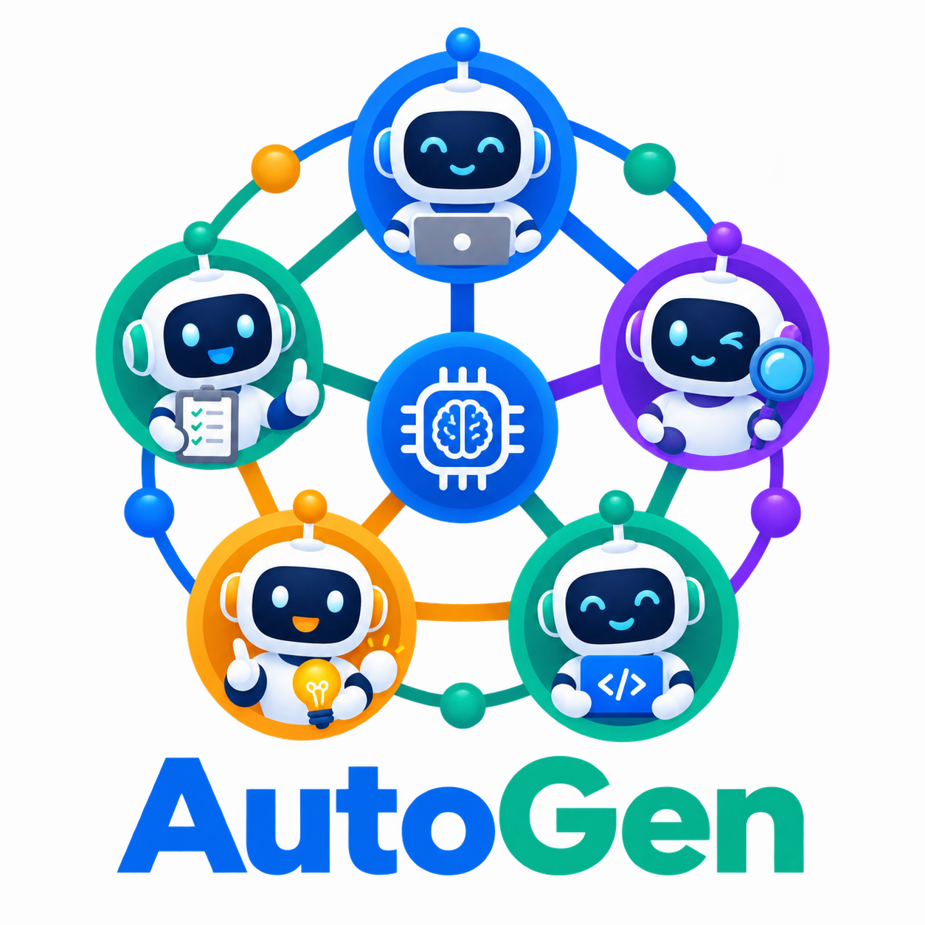
COURSE SLIDES · WSQ
Develop Multi-Agent AI Applications with AutoGen
WSQ Course Code: TGS-2024045806
Conducted by Tertiary Infotech Academy Pte Ltd · UEN 201200696W
Version v9 · 28 August 2026
© 2026 Tertiary Infotech Academy Pte Ltd. All rights reserved. · www.tertiarycourses.com.sg

Slide 2
COURSE ADMINISTRATION
Welcome & Housekeeping
Develop Multi-Agent AI Applications with AutoGen · TGS-2024045806
© 2026 Tertiary Infotech Academy Pte Ltd
2

Slide 3
TRAQOM · SSG DIGITAL ATTENDANCE
Digital Attendance (Mandatory)
Three times a day
Take the AM, PM and Assessment digital attendance — mandatory for every WSQ-funded course.
Trainer shows the QR
The trainer or administrator displays the digital attendance QR code from the SSG portal.
1
2
Scan and submit
Scan the QR code with your mobile phone camera and submit your attendance.
75% minimum
A minimum of 75% attendance is required to be eligible for assessment and funding.
3
4
Develop Multi-Agent AI Applications with AutoGen · TGS-2024045806
© 2026 Tertiary Infotech Academy Pte Ltd
3

Slide 4
YOUR TRAINER · GENERAL
About the Trainer
NAME
____________________________________________
?
TITLE / DESIGNATION
____________________________________________
QUALIFICATIONS
____________________________________________
Your Trainer
AREAS OF EXPERTISE
____________________________________________
General Trainer template —
to be completed by the trainer
TRAINING & INDUSTRY EXPERIENCE
____________________________________________
CONTACT
____________________________________________
Develop Multi-Agent AI Applications with AutoGen · TGS-2024045806
© 2026 Tertiary Infotech Academy Pte Ltd
4

Slide 5
YOUR TRAINER
About the Trainer
ROLE
Principal Trainer and Founder, Tertiary Infotech Academy Pte Ltd
AA
EXPERTISE
Generative AI, Large Language Models, multi-agent AI systems and applied machine learning.
Dr. Alfred Ang
DELIVERS
WSQ courses on AI agents, LLM application development, RAG, data science and automation.
Principal Trainer
Tertiary Infotech Academy Pte Ltd
FOUNDER
Founder and lead instructor at Tertiary Infotech / Tertiary Courses.
Develop Multi-Agent AI Applications with AutoGen · TGS-2024045806
© 2026 Tertiary Infotech Academy Pte Ltd
5

Slide 6
ICE-BREAKER
Let's Know Each Other
• Your name, organisation and role.
• Your experience with Python, APIs and Generative AI tools (if any).
• One workflow you would like a team of AI agents to automate for you.
Develop Multi-Agent AI Applications with AutoGen · TGS-2024045806
© 2026 Tertiary Infotech Academy Pte Ltd
6

Slide 7
HOUSEKEEPING
Ground Rules
Set your mobile phone to silent mode.
Participate actively — no question is too small.
1
2
Mutual respect: agree to disagree.
One conversation at a time.
3
4
Be punctual; return from breaks on time.
75% attendance is required.
5
6
Develop Multi-Agent AI Applications with AutoGen · TGS-2024045806
© 2026 Tertiary Infotech Academy Pte Ltd
7

Slide 8

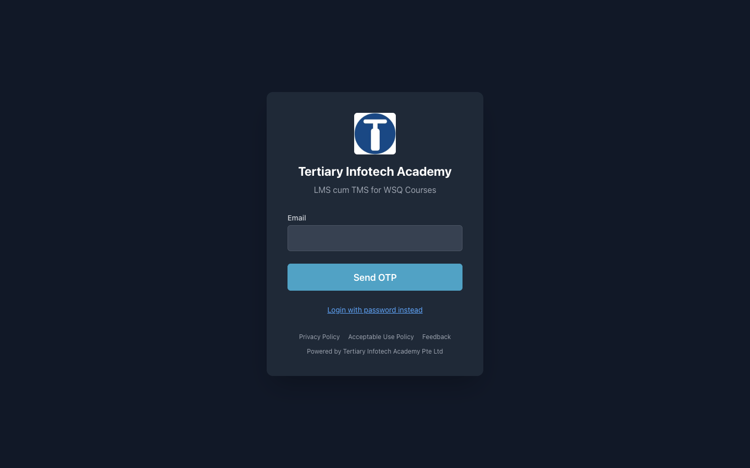
COURSE PORTAL
Login to LMS and Download Course Material
Log in at lms-tms.tertiaryinfotech.com with your registered email and the OTP sent to your inbox, then open this course to download the slides and Learner Guide.
Develop Multi-Agent AI Applications with AutoGen · TGS-2024045806
© 2026 Tertiary Infotech Academy Pte Ltd
8

Slide 9
SKILLS FRAMEWORK · TSC
Skills Framework Alignment
TSC Title
Artificial Intelligence Application
TSC Code
AER-TEM-4026-1.1
1
2
A1 / A2
Analyse algorithms in AI applications; correlate algorithm design with efficiency.
A3 / A4
Identify strengths and limitations of AI applications; evaluate various AI applications.
3
4
A5 / A6
Assess the feasibility of AI applications and the improvements they bring to processes.
K1–K6
AI application ranges, performance analysis, algorithm design and implementation concepts.
5
6
Develop Multi-Agent AI Applications with AutoGen · TGS-2024045806
© 2026 Tertiary Infotech Academy Pte Ltd
9

Slide 10
SCHEDULE
Lesson Plan — 2 Days, 8 Hours per Day
Day 1
Day 2
• Day 1 — LLM Orchestration & RAG with AutoGen
– Digital Attendance (AM) · Introductions · Learning Outcomes
– Topic 1: Introduction to LLM AI Orchestration (Labs 1–3)
– Lunch Break · Digital Attendance (PM)
– Topic 2: Retrieval-Augmented Generation (Labs 4–5)
– Day 1 recap and Q&A
• Day 2 — Multi-Agent Workflows & Assessment
– Digital Attendance (AM) · Day 1 recap
– Topic 3: Implementing a Multi-Agent AI Workflow (Labs 6–8)
– Lunch Break · Digital Attendance (PM)
– Revision · Course Feedback and TRAQOM Survey
– Digital Attendance (Assessment) · Final Assessment (WA + PP)
Develop Multi-Agent AI Applications with AutoGen · TGS-2024045806
© 2026 Tertiary Infotech Academy Pte Ltd
10

Slide 11
WHAT YOU'LL ACHIEVE
Learning Outcomes
LO1 · Evaluate LLM AI models
Identify the strengths and limitations of LLM AI models by running, measuring and comparing them.
1
LO2 · Analyze RAG algorithms
Analyze Retrieval-Augmented Generation algorithms — embeddings, chunking, similarity search — to improve efficiency.
2
LO3 · Assess multi-agent feasibility
Assess the feasibility of implementing multi-agent AI applications with evidence: cost, latency, guardrails and readiness checks.
3
Develop Multi-Agent AI Applications with AutoGen · TGS-2024045806
© 2026 Tertiary Infotech Academy Pte Ltd
11

Slide 12
THREE TOPICS · 8 HANDS-ON LABS
Course Outline
Topic 1 — Introduction to LLM AI Orchestration
LLM strengths & limitations · AI agents · AutoGen setup · model clients · function-calling tools · Labs 1–3.
1
Topic 2 — Retrieval-Augmented Generation (RAG)
Embeddings · chunking · vector databases · similarity search · grounded RAG agents · evaluation · Labs 4–5.
2
Topic 3 — Implementing a Multi-Agent AI Workflow
ReAct · human-in-the-loop · round-robin teams · SelectorGroupChat routing · feasibility · Labs 6–8.
3
Develop Multi-Agent AI Applications with AutoGen · TGS-2024045806
© 2026 Tertiary Infotech Academy Pte Ltd
12

Slide 13
BEFORE YOU START
Briefing for Assessment
Do · Clear your desk
Place phones and other materials under the table or on the floor.
Don't · No recording
No photos or recording of assessment scripts.
1
2
Don't · No discussion
Work individually — no discussion during the assessment.
Do · Black or blue pen
Use a black or blue pen for hard-copy assessments.
3
4
Don't · No correction fluid
No liquid paper or correction tape may be used.
Do · Stop on time
Scripts are collected when time is up.
5
6
Develop Multi-Agent AI Applications with AutoGen · TGS-2024045806
© 2026 Tertiary Infotech Academy Pte Ltd
13

Slide 14
DAY 2 · 4:30 PM
Final Assessment
Written Assessment (WA)
Short-Answer Questions (SAQ) · 1 hour · open book. Tests the underpinning knowledge in these slides.
Practical Performance (PP)
Hands-on AutoGen build tasks · 1 hour · open book. Tests the ability you built in the labs.
1
2
Open book
You may use the course slides, the Learner Guide and approved materials only.
Eligibility
A minimum of 75% attendance is required to be eligible for assessment and funding.
3
4
Result
You are assessed as Competent (C) or Not Yet Competent (NYC) on each instrument.
Appeals
An appeal process is available if you wish to contest an assessment outcome.
5
6
Develop Multi-Agent AI Applications with AutoGen · TGS-2024045806
© 2026 Tertiary Infotech Academy Pte Ltd
14

Slide 15
ON ASSESSMENT DAY
Assessment Flow
1
2
3
4
5
TRAQOM survey
Digital attendance
Sit WA then PP
Submit on the LMS
Sign the record
Scan the QR code on the…
Scan the SSG assessment QR
Open book · 1 hour each
Upload your completed…
Sign the Assessment…
REMEMBER
All five steps are mandatory for WSQ funding — missing the digital attendance or the TRAQOM survey can invalidate your claim.
Develop Multi-Agent AI Applications with AutoGen · TGS-2024045806
© 2026 Tertiary Infotech Academy Pte Ltd
15

Slide 16
WSQ FUNDING
Criteria for Funding
Attendance
A minimum attendance rate of 75%, based on the SSG Digital Attendance record.
Assessment
Complete both assessment components and be assessed as 'Competent'.
1
2
Digital attendance
Scan the SSG QR code for AM, PM and Assessment on every training day.
TRAQOM survey
Complete the mandatory TRAQOM course feedback survey on the LMS.
3
4
Develop Multi-Agent AI Applications with AutoGen · TGS-2024045806
© 2026 Tertiary Infotech Academy Pte Ltd
16

Slide 17
PRACTICE EXAM · exams.tertiaryinfotech.com
Practice Exams — Sharpen Your Readiness
Practice portal
https://exams.tertiaryinfotech.com/practice-exams — free Tertiary Infotech practice exams.
Why practise
Timed question practice builds the recall you need for the open-book WA (SAQ).
1
2
How to use it
Create a free account, pick an AI/agents practice exam, and review every explanation.
Best preparation
Redo the 8 labs from a blank file — the PP mirrors what you built in class.
3
4
Develop Multi-Agent AI Applications with AutoGen · TGS-2024045806
© 2026 Tertiary Infotech Academy Pte Ltd
17

Slide 18
LAB ENVIRONMENT · labs/lab-00-prelab-uv-setup
Set Up Before We Start (Pre-Lab)
Install uv
curl -LsSf https://astral.sh/uv/install.sh | sh (or the PowerShell one-liner on Windows).
Clone the labs
git clone the course repository from GitHub — the link is on your LMS course page.
1
2
Sync the environment
cd labs && uv sync — installs Python, AutoGen AgentChat, Extensions and ChromaDB.
Set your API key
cp .env.example .env and paste the OPENAI_API_KEY the trainer provides.
3
4
Verify
uv run python -c "import autogen_agentchat" prints no error.
Editor
Use VS Code or any editor you are comfortable with.
5
6
Develop Multi-Agent AI Applications with AutoGen · TGS-2024045806
© 2026 Tertiary Infotech Academy Pte Ltd
18

Slide 19
CORE CONCEPTS
From Large Language Models to Multi-Agent AI
Develop Multi-Agent AI Applications with AutoGen · TGS-2024045806
© 2026 Tertiary Infotech Academy Pte Ltd
19

Slide 20
FOUNDATIONS
What is a Large Language Model?
A model of language
An LLM such as GPT-4o, Claude or Gemini is trained to understand and generate human language.
Why 'large'
Large in training data and parameters — hundreds of billions of learned weights.
1
2
Autoregressive
It predicts the next token, one token at a time, conditioned on everything written so far.
Trained then inferred
Training builds the model from a huge corpus; inference is the prompt-and-response you use every day.
3
4
Develop Multi-Agent AI Applications with AutoGen · TGS-2024045806
© 2026 Tertiary Infotech Academy Pte Ltd
20

Slide 21
AUTOREGRESSIVE GENERATION
How an LLM Produces an Answer
1
2
3
4
5
▶
▶
▶
▶
Your prompt is broken into tokens
The model attends over the full context
It predicts the most likely next token
The token is appended and the loop repeats
Generation stops at a stop token or limit
Develop Multi-Agent AI Applications with AutoGen · TGS-2024045806
© 2026 Tertiary Infotech Academy Pte Ltd
21

Slide 22
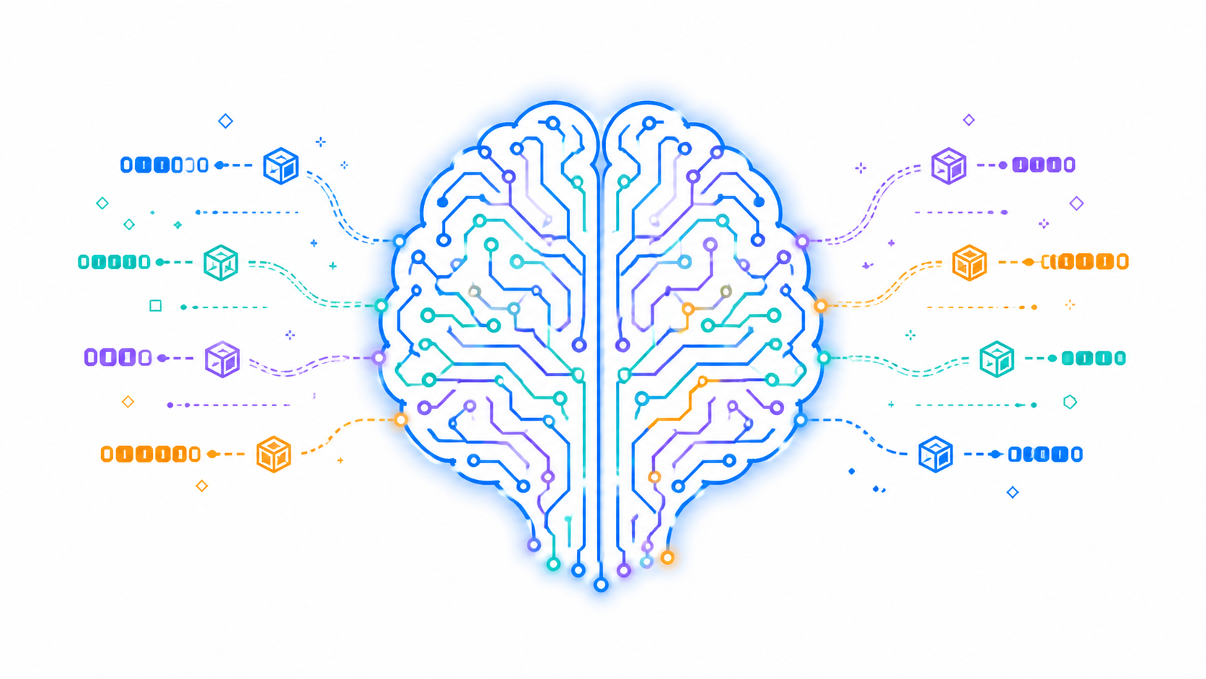
LO1 · THE FOUNDATION
The Engine of Every Agent — the LLM
THE IDEA
Everything in this course sits on top of one capability: a model that turns context into the most plausible next token. Orchestration is the discipline of making that capability reliable.
Develop Multi-Agent AI Applications with AutoGen · TGS-2024045806
© 2026 Tertiary Infotech Academy Pte Ltd
22

Slide 23
LO1 · EVALUATING MODELS
LLM Strengths vs Limitations
What LLMs do well
What you must manage
• Strengths
– Fluent generation, summarisation and translation
– Broad general knowledge from pre-training
– In-context learning from a few examples
– Function calling for structured actions
• Limitations
– Hallucination — confident but wrong output
– Knowledge cut-off — no events after training
– Stateless — no memory between calls
– Non-deterministic at temperature > 0 · context limits · cost
Develop Multi-Agent AI Applications with AutoGen · TGS-2024045806
© 2026 Tertiary Infotech Academy Pte Ltd
23

Slide 24
LO1 · MEASURABLE AXES
How to Evaluate an LLM for Your Application
Axis
What you measure
How to measure it
Seen in lab
Quality
Task accuracy, groundedness
Gold questions, human review
Labs 1, 5
Latency
Seconds per response
Timing wrapper around the call
Lab 2
Cost
Tokens in + out per call
response.usage token counts
Lab 1
Repeatability
Same input → same output?
Run twice at temperature 0
Lab 1
Privacy
Where does data go?
Cloud API vs local Ollama model
Lab 2
WHEN IT MATTERS Model choice is an engineering decision made with numbers — not a brand preference.
Develop Multi-Agent AI Applications with AutoGen · TGS-2024045806
© 2026 Tertiary Infotech Academy Pte Ltd
24

Slide 25
LO1 · INDICATIVE 1–10 SCORES
Cloud vs Local Model — the Trade-off
WHAT THE DATA SHOWS
Indicative teaching scores, not benchmarks: the cloud model wins on quality; the local model wins on cost and privacy. Lab 2 measures this trade-off on your own machine.
Develop Multi-Agent AI Applications with AutoGen · TGS-2024045806
© 2026 Tertiary Infotech Academy Pte Ltd
25

Slide 26
WHY AGENTS
An LLM answers. An agent acts.
An AI agent wraps the model with a role, memory and tools — so it can complete tasks, not just produce text.
Develop Multi-Agent AI Applications with AutoGen · TGS-2024045806
© 2026 Tertiary Infotech Academy Pte Ltd
26

Slide 27
THE SIX INGREDIENTS
What Makes a System 'Agentic'?
Reasoning
The model plans a sequence of steps instead of answering in one shot.
Tool use
It calls functions and APIs to fetch live data or take real actions.
1
2
Memory
Conversation context lets it carry state across many turns.
Autonomy
It decides which tool to call — or which specialist agent should act next.
3
4
Collaboration
Multiple specialised agents divide the work and hand off between themselves.
Guardrails
System messages, termination conditions and human approval constrain what it may do.
5
6
Develop Multi-Agent AI Applications with AutoGen · TGS-2024045806
© 2026 Tertiary Infotech Academy Pte Ltd
27

Slide 28
THE PATTERN BEHIND EVERY AGENT
The Agentic Loop — Reason, Act, Observe
1
2
3
4
5
Perceive
Reason
Act
Observe
Respond
Read the request and…
Plan which step or tool…
Call a tool, or hand off…
Read the tool result back…
Answer, or loop again if…
WHY IT MATTERS
The loop is what separates an agent from a chatbot: it can take several actions before answering, and it decides how many.
Develop Multi-Agent AI Applications with AutoGen · TGS-2024045806
© 2026 Tertiary Infotech Academy Pte Ltd
28

Slide 29
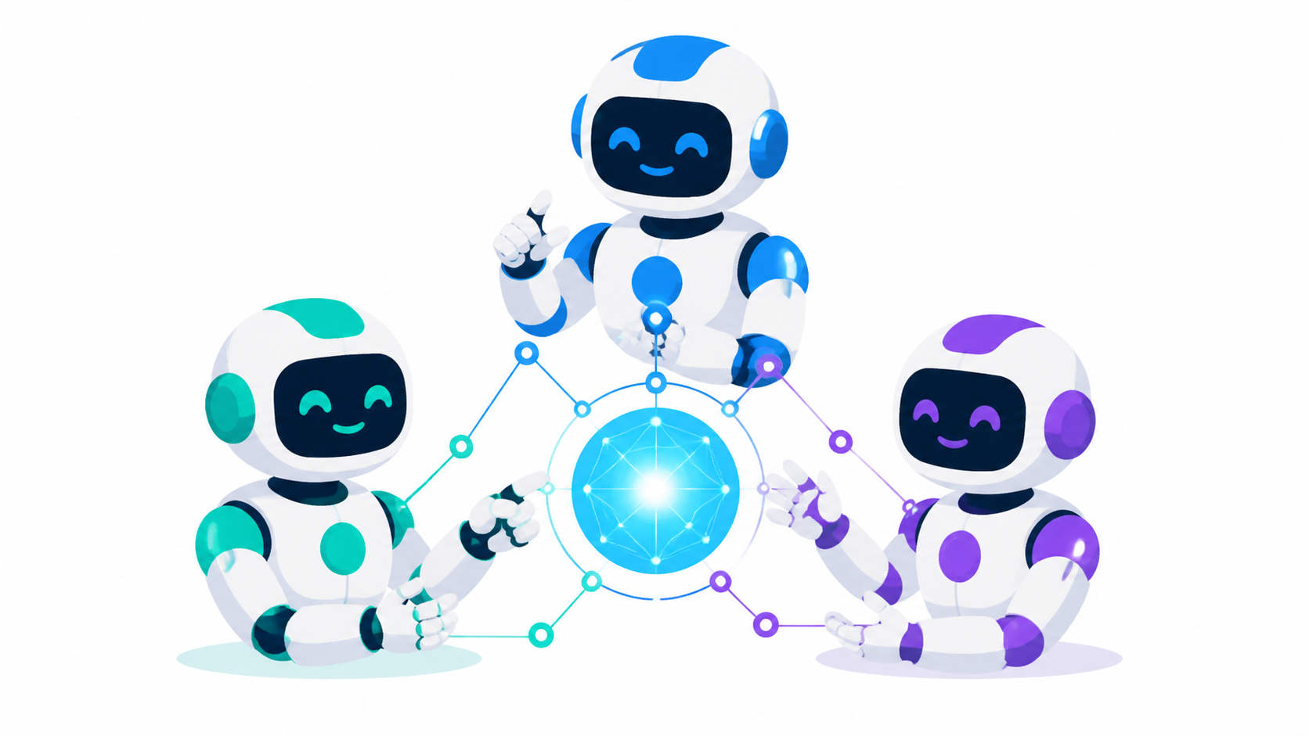
THE BIG IDEA
Multi-Agent Systems — Specialists That Collaborate
THE IDEA
One agent with twenty jobs fails quietly; several agents with one job each can be tested, routed and trusted. Dividing work across specialists is the core idea of this course.
Develop Multi-Agent AI Applications with AutoGen · TGS-2024045806
© 2026 Tertiary Infotech Academy Pte Ltd
29

Slide 30
LO3 · CHOOSING THE RIGHT ARCHITECTURE
LLM vs Single Agent vs Multi-Agent System
Dimension
Plain LLM
Single Agent
Multi-Agent System
What it does
Generates text
Completes a task
Divides work across specialists
Memory
None — stateless
Conversation context
Shared team conversation
Tools
None
Its own tool set
Each agent has its own tools
Best for
Drafting, summarising
One well-defined job
Broad domains, varied requests
Main risk
Hallucination
Overloaded instruction
Wrong routing / endless loops
WHEN IT MATTERS Add agents only when one instruction can no longer describe the job clearly — complexity you don't need is complexity you must still debug.
Develop Multi-Agent AI Applications with AutoGen · TGS-2024045806
© 2026 Tertiary Infotech Academy Pte Ltd
30

Slide 31
WHY NOW
From RPA to Agentic Process Automation
Yesterday
Today
• RPA — Robotic Process Automation
– Scripted clicks and keystrokes
– Breaks when the screen changes
– No understanding of content
– Good for stable, repetitive flows
• APA — Agentic Process Automation
– Agents reason about goals, not scripts
– Adapts: reads content, decides, calls tools
– Handles exceptions and hands off to humans
– Good for knowledge work with variation
Develop Multi-Agent AI Applications with AutoGen · TGS-2024045806
© 2026 Tertiary Infotech Academy Pte Ltd
31

Slide 32
LO3 · WHERE IT PAYS OFF
Industry Use Cases of Multi-Agent AI
Customer Support
Finance & Operations
Software & Data
• L1 triage agent classifies tickets
• Knowledge agent drafts grounded replies
• Escalation agent routes to humans
• 24/7 first response, faster resolution
• Research + analysis agent pairs
• Report writer with reviewer agent
• Compliance checks with citations
• Human approval before anything ships
• Coder + tester agent loops
• Data-pipeline monitoring agents
• Documentation writers with critics
• Feasibility checks before rollout
Develop Multi-Agent AI Applications with AutoGen · TGS-2024045806
© 2026 Tertiary Infotech Academy Pte Ltd
32

Slide 33
LO3 · KNOW YOUR OPTIONS
Multi-Agent Frameworks — the Landscape
Framework
Orchestration style
Strengths
Best fit
AutoGen
Conversation-driven teams
Teams, tools, human-in-loop, Studio UI
This course — flexible agent teams
LangGraph
Explicit state graph
Deterministic flows, persistence
Regulated, auditable pipelines
CrewAI
Role/task crews
Fast role-based prototyping
Content and research crews
Semantic Kernel
Skills + planners
.NET/enterprise integration
Microsoft-stack enterprises
WHEN IT MATTERS The concepts transfer: agents, tools, memory and termination exist in every framework — AutoGen is our vehicle for learning them.
Develop Multi-Agent AI Applications with AutoGen · TGS-2024045806
© 2026 Tertiary Infotech Academy Pte Ltd
33

Slide 34
TOPIC 1 PREVIEW
What is AutoGen?
Microsoft open source
A framework for building multi-agent AI applications, maintained by Microsoft Research.
Conversation-first
Agents collaborate by exchanging messages in shared team conversations.
1
2
Batteries included
Model clients, tools, teams, termination conditions and human-in-the-loop out of the box.
Production path
The same concepts scale from a script to AutoGen Studio to the event-driven Core runtime.
3
4
Develop Multi-Agent AI Applications with AutoGen · TGS-2024045806
© 2026 Tertiary Infotech Academy Pte Ltd
34

Slide 35
FOUR LAYERS, ONE FRAMEWORK
The AutoGen Stack
1
2
3
4
autogen-core
autogen-agentchat
autogen-ext
AutoGen Studio
Event-driven agent runtime
Agents, teams, termination…
Model clients & tools
No-code team builder
WHERE WE WORK
This course lives in agentchat + ext — the task-driven layer most applications use. Studio gives the same power without code.
Develop Multi-Agent AI Applications with AutoGen · TGS-2024045806
© 2026 Tertiary Infotech Academy Pte Ltd
35

Slide 36
LO3 · WORKED EXAMPLE
Reading an AutoGen Agent Definition
Every agent in this course is built from these same fields — learn to read them once.
from autogen_agentchat.agents import AssistantAgent
from autogen_ext.models.openai import (
OpenAIChatCompletionClient,
)
client = OpenAIChatCompletionClient(
model='gpt-4o-mini',
)
agent = AssistantAgent(
name='ops_assistant',
model_client=client,
system_message='You are ...',
tools=[lookup_ticket],
)
model_client
Which LLM runs the agent — swap OpenAI for Azure, Gemini or Ollama here.
name
The identifier used in team conversations and routing.
system_message
The role, rules and refusals. Most behaviour lives here.
tools
Typed Python functions the agent may call — its hands.
Develop Multi-Agent AI Applications with AutoGen · TGS-2024045806
© 2026 Tertiary Infotech Academy Pte Ltd
36

Slide 37
LO3 · DESIGN DECISION
Which Agent Pattern Should You Use?
YES — use a single agent
Can one clear
instruction describe
the whole job?
Give it the tools it needs. Simpler to build, cheaper to run and far easier to debug. Most business tasks stop here.
NO — use a team
Split by specialism. RoundRobinGroupChat when the order is fixed; SelectorGroupChat when an LLM should route dynamically.
A common mistake is starting multi-agent. Start single, and split only when the instruction starts listing unrelated responsibilities.
Develop Multi-Agent AI Applications with AutoGen · TGS-2024045806
© 2026 Tertiary Infotech Academy Pte Ltd
37

Slide 38
LESSON PLAN · TIME ALLOCATION
Where Course Time Goes — Topic Weighting
WHAT THE DATA SHOWS
Topics 1 and 2 build the orchestration and RAG foundations; Topic 3 assembles them into multi-agent workflows — the skill the practical assessment weighs most.
Develop Multi-Agent AI Applications with AutoGen · TGS-2024045806
© 2026 Tertiary Infotech Academy Pte Ltd
38

Slide 39
01
TOPIC 01
Introduction to LLM AI Orchestration
LLM strengths & limitations · AI agents · AutoGen setup · model clients · tools
Develop Multi-Agent AI Applications with AutoGen · TGS-2024045806
© 2026 Tertiary Infotech Academy Pte Ltd
39

Slide 40
TOPIC WEIGHTING 36%
Key Concepts — Introduction to LLM AI Orchestration
1
An LLM generates text token by token from a prompt; it is stateless, has a knowledge cut-off, and can hallucinate — the limitations that orchestration exists to manage.
2
Strengths and limitations are evaluated on measurable axes: quality, latency, cost per call, context length, privacy and repeatability (temperature).
3
An AI agent wraps an LLM with a role (system message), memory of the conversation, and tools — so it can act, not just answer.
4
AutoGen is Microsoft's open-source multi-agent framework: Core (event-driven runtime), AgentChat (task-driven agents & teams), Extensions (model clients, tools) and Studio (no-code UI).
Develop Multi-Agent AI Applications with AutoGen · TGS-2024045806
© 2026 Tertiary Infotech Academy Pte Ltd
40

Slide 41
TOPIC WEIGHTING 36%
Key Concepts — Introduction to LLM AI Orchestration (continued)
1
A model client (OpenAIChatCompletionClient) abstracts the provider — the same agent code runs on OpenAI, Azure, Gemini, or a local Ollama model.
2
Function calling turns typed Python functions into tools the model can request; AutoGen's FunctionTool generates the JSON schema from the signature and docstring.
3
Structured output (output_content_type with a Pydantic model) converts free text into validated fields that downstream code can branch on.
4
Async execution (asyncio, run/run_stream, the Console UI) is how AgentChat streams events and scales beyond one blocking call.
Develop Multi-Agent AI Applications with AutoGen · TGS-2024045806
© 2026 Tertiary Infotech Academy Pte Ltd
41

Slide 42
TOPIC 01 · ORCHESTRATION
LLM AI Orchestration — What and Why
Definition
Coordinating models, prompts, tools, data and control flow into one dependable application.
Beyond one prompt
Real apps chain calls, branch on results, retry failures and log everything.
1
2
The orchestrator's job
Decide what runs, in what order, with what context — and when to stop.
Frameworks help
AutoGen supplies the loop, message types, tool plumbing and termination logic.
3
4
Develop Multi-Agent AI Applications with AutoGen · TGS-2024045806
© 2026 Tertiary Infotech Academy Pte Ltd
42

Slide 43
TOPIC 01 · LOCAL LLM
Running a Local LLM with Ollama
Why local
Privacy (data never leaves the machine), zero per-call cost, offline capability.
Install & pull
ollama pull llama3.2 downloads a quantised open model to your laptop.
1
2
OpenAI-compatible
Ollama serves http://localhost:11434/v1 — the SAME client code works against it.
The catch
Smaller local models trade answer quality and speed for privacy and cost — measure it in Lab 2.
3
4
Develop Multi-Agent AI Applications with AutoGen · TGS-2024045806
© 2026 Tertiary Infotech Academy Pte Ltd
43

Slide 44
TOPIC 01 · WORKED EXAMPLE
Building a Minimal LLM App
Lab 1's llm_app.py — the irreducible core of every LLM application.
from openai import OpenAI
client = OpenAI(api_key=KEY)
resp = client.chat.completions.create(
model='gpt-4o-mini',
temperature=0.7,
messages=[
{'role':'system','content':'...'},
{'role':'user','content':'...'},
],
)
print(resp.choices[0].message.content)
print(resp.usage.total_tokens)
messages
The whole conversation is sent every call — the model itself is stateless.
temperature
0 = repeatable, higher = varied. Your first debugging lever.
usage
Token counts are your cost meter — log them from day one.
choices[0]
The reply. Everything else in this course wraps this call.
Develop Multi-Agent AI Applications with AutoGen · TGS-2024045806
© 2026 Tertiary Infotech Academy Pte Ltd
44

Slide 45
TOPIC 01 · DEBUGGING
Debugging an LLM App
Log the full prompt
Most 'model bugs' are prompt bugs — print exactly what was sent.
Fix the temperature
Set temperature=0 while debugging so runs are comparable.
1
2
Watch the tokens
Truncated answers usually mean a max-token or context limit was hit.
Isolate the layer
Test the raw API call first (Lab 1), then the agent wrapper — never both at once.
3
4
Read the events
AutoGen streams every message and tool call — the Console UI is your trace.
Reproduce cheaply
Keep a failing prompt as a test case you can re-run after every change.
5
6
Develop Multi-Agent AI Applications with AutoGen · TGS-2024045806
© 2026 Tertiary Infotech Academy Pte Ltd
45

Slide 46
TOPIC 01 · TOOLS
How Function Calling Works
1
2
3
4
5
Declare
Decide
Execute
Return
Answer
Tool schema sent with the…
Model returns a tool_call…
YOUR code runs the…
Result goes back to the…
Model writes the final…
THE KEY INSIGHT
The model never executes anything — it only asks. Your code stays in control of every action, which is where safety lives.
Develop Multi-Agent AI Applications with AutoGen · TGS-2024045806
© 2026 Tertiary Infotech Academy Pte Ltd
46

Slide 47
TOPIC 01 · TOOL SOURCES
Three Kinds of Tools in AutoGen
Custom FunctionTool
Built-in / Extensions
Third-party APIs
• Any typed Python function
• Schema generated from the signature
• Docstring becomes the description
• Labs 3–5, 8 use these
• autogen-ext ships ready-made tools
• HTTP requests, code execution, MCP
• Install-and-go integrations
• Explore: autogen_ext.tools
• Wrap any REST API in a function
• Weather, search (Tavily), arXiv…
• Keep keys in .env, never in code
• Same FunctionTool pattern
Develop Multi-Agent AI Applications with AutoGen · TGS-2024045806
© 2026 Tertiary Infotech Academy Pte Ltd
47

Slide 48
WHAT YOU'LL DO
Hands-On Labs — Introduction to LLM AI Orchestration
Lab 1
Lab 2
Lab 3
• Set Up AutoGen and Run Your First Agent
• Configure Model Clients and Structured Output
• Equip an Agent with Tools
Develop Multi-Agent AI Applications with AutoGen · TGS-2024045806
© 2026 Tertiary Infotech Academy Pte Ltd
48

Slide 49
TOPIC 01 · HANDS-ON
Set Up AutoGen and Run Your First Agent
LAB 1
LO1 — evaluate an LLM by running it directly, then as an AutoGen agent.
Verify the uv lab environment from the Pre-Lab, call an LLM directly with the OpenAI SDK, then wrap the same model in an AutoGen AssistantAgent and stream its reply with the Console UI.
YOU'LL BUILD
TOOLCHAIN
DONE WHEN
A working AutoGen environment plus two runnable scripts: a plain LLM app and your first agent.
uv, Python 3.10+, OpenAI SDK, AutoGen AgentChat, Console UI
Both scripts print a model reply with no traceback, and you can state one strength (fluent answers) and one limitation (stateless, non-repeatable at temperature 0.7) you just observed.
Develop Multi-Agent AI Applications with AutoGen · TGS-2024045806
© 2026 Tertiary Infotech Academy Pte Ltd
49

Slide 50
LAB 1 · PROCESS MAP
How Lab 1 Runs
1
2
3
4
5
Complete the Pre-Lab: install uv
Create your .env with the course API key
Verify AutoGen imports cleanly in the…
Run the plain-Python LLM app
Run the same model as an AutoGen…
uv sync
cp .env.example .env
-c …
…/llm_app.py
…/first_agent.py
THE POINT
LO1 — evaluate an LLM by running it directly, then as an AutoGen agent.
Develop Multi-Agent AI Applications with AutoGen · TGS-2024045806
© 2026 Tertiary Infotech Academy Pte Ltd
50

Slide 51
LAB 1 · PROCEDURE
Set Up AutoGen and Run Your First Agent — Part 1/2
Complete the Pre-Lab: install uv, then sync the lab environment
1
$ uv sync
Create your .env with the course API key (never commit it)
2
$ cp .env.example .env
Verify AutoGen imports cleanly in the environment
3
$ uv run python -c "import autogen_agentchat; print('OK')"
Run the plain-Python LLM app and note the reply and token count
4
$ uv run python lab-01-first-autogen-agent/llm_app.py
Develop Multi-Agent AI Applications with AutoGen · TGS-2024045806
© 2026 Tertiary Infotech Academy Pte Ltd
51

Slide 52
LAB 1 · PROCEDURE
Set Up AutoGen and Run Your First Agent — Part 2/2
Run the same model as an AutoGen AssistantAgent with streaming
5
$ uv run python lab-01-first-autogen-agent/first_agent.py
Set temperature to 0 in llm_app.py and re-run twice to compare repeatability
6
Develop Multi-Agent AI Applications with AutoGen · TGS-2024045806
© 2026 Tertiary Infotech Academy Pte Ltd
52

Slide 53
LAB 1 · VERIFY
Set Up AutoGen and Run Your First Agent
✅ Expected result
Both scripts print a model reply with no traceback, and you can state one strength (fluent answers) and one limitation (stateless, non-repeatable at temperature 0.7) you just observed.
IF IT DOESN'T WORK
Nothing happens
Auth or 401 error
ModuleNotFoundError
Check the .env file is in the labs folder and the key has no quotes or spaces.
Re-copy the OPENAI_API_KEY into labs/.env — no quotes, no spaces.
Run uv sync again, and prefix commands with uv run so the venv is used.
Develop Multi-Agent AI Applications with AutoGen · TGS-2024045806
© 2026 Tertiary Infotech Academy Pte Ltd
53

Slide 54
TOPIC 01 · HANDS-ON
Configure Model Clients and Structured Output
LAB 2
LO1 — compare cloud vs local models and constrain output to a schema.
Run the same prompt against OpenAI's cloud API and a local Ollama model to compare quality, latency and cost, then force an AutoGen agent to reply in a validated Pydantic TicketTriage schema instead of free text.
YOU'LL BUILD
TOOLCHAIN
DONE WHEN
A model-comparison script with timings, and a triage agent that returns validated JSON fields.
OpenAIChatCompletionClient, Ollama (optional), Pydantic, output_content_type
The triage agent returns a valid TicketTriage object with priority P1 for the outage ticket; you can name the trade-offs (latency, cost, privacy, quality) between the cloud and local model.
Develop Multi-Agent AI Applications with AutoGen · TGS-2024045806
© 2026 Tertiary Infotech Academy Pte Ltd
54

Slide 55
LAB 2 · PROCESS MAP
How Lab 2 Runs
1
2
3
4
5
Run the model-client comparison
Optional: install Ollama
Read the TicketTriage Pydantic schema — the…
Run the structured-output triage agent on…
Change the ticket text to a P4 request
…/model_clients.py
ollama pull llama3.2
…/structured_agent.py
THE POINT
LO1 — compare cloud vs local models and constrain output to a schema.
Develop Multi-Agent AI Applications with AutoGen · TGS-2024045806
© 2026 Tertiary Infotech Academy Pte Ltd
55

Slide 56
LAB 2 · PROCEDURE
Configure Model Clients and Structured Output — Part 1/2
Run the model-client comparison (OpenAI cloud, with timing)
1
$ uv run python lab-02-model-clients-structured-output/model_clients.py
Optional: install Ollama and pull a local model, then re-run to compare
2
$ ollama pull llama3.2
Read the TicketTriage Pydantic schema — the contract the agent must obey
3
Run the structured-output triage agent on the outage ticket
4
$ uv run python lab-02-model-clients-structured-output/structured_agent.py
Develop Multi-Agent AI Applications with AutoGen · TGS-2024045806
© 2026 Tertiary Infotech Academy Pte Ltd
56

Slide 57
LAB 2 · PROCEDURE
Configure Model Clients and Structured Output — Part 2/2
Change the ticket text to a P4 request and re-run — watch the fields change
5
Develop Multi-Agent AI Applications with AutoGen · TGS-2024045806
© 2026 Tertiary Infotech Academy Pte Ltd
57

Slide 58
LAB 2 · VERIFY
Configure Model Clients and Structured Output
✅ Expected result
The triage agent returns a valid TicketTriage object with priority P1 for the outage ticket; you can name the trade-offs (latency, cost, privacy, quality) between the cloud and local model.
IF IT DOESN'T WORK
Nothing happens
Auth or 401 error
ModuleNotFoundError
Check the .env file is in the labs folder and the key has no quotes or spaces.
Re-copy the OPENAI_API_KEY into labs/.env — no quotes, no spaces.
Run uv sync again, and prefix commands with uv run so the venv is used.
Develop Multi-Agent AI Applications with AutoGen · TGS-2024045806
© 2026 Tertiary Infotech Academy Pte Ltd
58

Slide 59
TOPIC 01 · HANDS-ON
Equip an Agent with Tools
LAB 3
LO1 — extend an LLM's limits with function calling and FunctionTool.
Do raw OpenAI function calling by hand against the synthetic ticket dataset, then let AutoGen's FunctionTool generate the schema, execute the calls and reflect on the results with two read-only ticket tools.
YOU'LL BUILD
TOOLCHAIN
DONE WHEN
A hand-rolled function-calling round trip, and a help-desk agent with lookup_ticket and count_open_tickets tools.
OpenAI function calling, FunctionTool, reflect_on_tool_use, tickets.json mock data
The agent reports the real subject of TT-1005 and the correct count of open P2 tickets — every fact traceable to a tool result, none invented.
Develop Multi-Agent AI Applications with AutoGen · TGS-2024045806
© 2026 Tertiary Infotech Academy Pte Ltd
59

Slide 60
LAB 3 · PROCESS MAP
How Lab 3 Runs
1
2
3
4
5
Inspect the synthetic ticket data the tools…
Run raw function calling: schema →…
Read tool_agent.py — one typed Python…
Run the AutoGen tool agent
Ask a question needing BOTH tools
cat data/tickets.json
…/function_calling.py
…/tool_agent.py
THE POINT
LO1 — extend an LLM's limits with function calling and FunctionTool.
Develop Multi-Agent AI Applications with AutoGen · TGS-2024045806
© 2026 Tertiary Infotech Academy Pte Ltd
60

Slide 61
LAB 3 · PROCEDURE
Equip an Agent with Tools — Part 1/2
Inspect the synthetic ticket data the tools will read
1
$ cat data/tickets.json
Run raw function calling: schema → tool_call → execute → final answer
2
$ uv run python lab-03-agent-tools/function_calling.py
Read tool_agent.py — one typed Python function becomes one FunctionTool line
3
Run the AutoGen tool agent and watch ToolCallRequestEvent / ToolCallExecutionEvent
4
$ uv run python lab-03-agent-tools/tool_agent.py
Develop Multi-Agent AI Applications with AutoGen · TGS-2024045806
© 2026 Tertiary Infotech Academy Pte Ltd
61

Slide 62
LAB 3 · PROCEDURE
Equip an Agent with Tools — Part 2/2
Ask a question needing BOTH tools and confirm two tool calls are made
5
Develop Multi-Agent AI Applications with AutoGen · TGS-2024045806
© 2026 Tertiary Infotech Academy Pte Ltd
62

Slide 63
LAB 3 · VERIFY
Equip an Agent with Tools
✅ Expected result
The agent reports the real subject of TT-1005 and the correct count of open P2 tickets — every fact traceable to a tool result, none invented.
IF IT DOESN'T WORK
Nothing happens
Auth or 401 error
ModuleNotFoundError
Check the .env file is in the labs folder and the key has no quotes or spaces.
Re-copy the OPENAI_API_KEY into labs/.env — no quotes, no spaces.
Run uv sync again, and prefix commands with uv run so the venv is used.
Develop Multi-Agent AI Applications with AutoGen · TGS-2024045806
© 2026 Tertiary Infotech Academy Pte Ltd
63

Slide 64
TOPIC RECAP
Recap — Introduction to LLM AI Orchestration
• You can now: evaluate an LLM by running it directly, then as an AutoGen agent.
• You can now: compare cloud vs local models and constrain output to a schema.
• You can now: extend an LLM's limits with function calling and FunctionTool.
Develop Multi-Agent AI Applications with AutoGen · TGS-2024045806
© 2026 Tertiary Infotech Academy Pte Ltd
64

Slide 65
02
TOPIC 02
Retrieval-Augmented Generation (RAG)
Embeddings · chunking · vector database · similarity search · grounded agents · evaluation
Develop Multi-Agent AI Applications with AutoGen · TGS-2024045806
© 2026 Tertiary Infotech Academy Pte Ltd
65

Slide 66
TOPIC WEIGHTING 36%
Key Concepts — Retrieval-Augmented Generation (RAG)
1
RAG lets an LLM answer from knowledge outside its training data by retrieving relevant text and stuffing it into the prompt — fresher answers, fewer hallucinations, source citations.
2
A text embedding maps text to a vector; semantically similar texts land close together, so meaning becomes measurable as cosine similarity.
3
Chunking decides what one retrievable unit is; chunk boundaries (by section, paragraph or tokens, with overlap) directly change retrieval quality.
4
A vector database (ChromaDB) stores embeddings and answers approximate nearest-neighbour queries in milliseconds.
Develop Multi-Agent AI Applications with AutoGen · TGS-2024045806
© 2026 Tertiary Infotech Academy Pte Ltd
66

Slide 67
TOPIC WEIGHTING 36%
Key Concepts — Retrieval-Augmented Generation (RAG) (continued)
The RAG pipeline: load → chunk → embed → store at indexing time; embed query → similarity search → augment prompt → generate at answer time.
1
An agentic RAG agent calls retrieval as a tool, cites source ids, and refuses when evidence is missing — and treats retrieved text as data, never as instructions (prompt-injection defence).
2
RAG efficiency is analysed with numbers: hit@k retrieval accuracy on a gold question set, retrieval latency, chunk count and top-k — change one lever, re-measure.
3
Develop Multi-Agent AI Applications with AutoGen · TGS-2024045806
© 2026 Tertiary Infotech Academy Pte Ltd
67

Slide 68
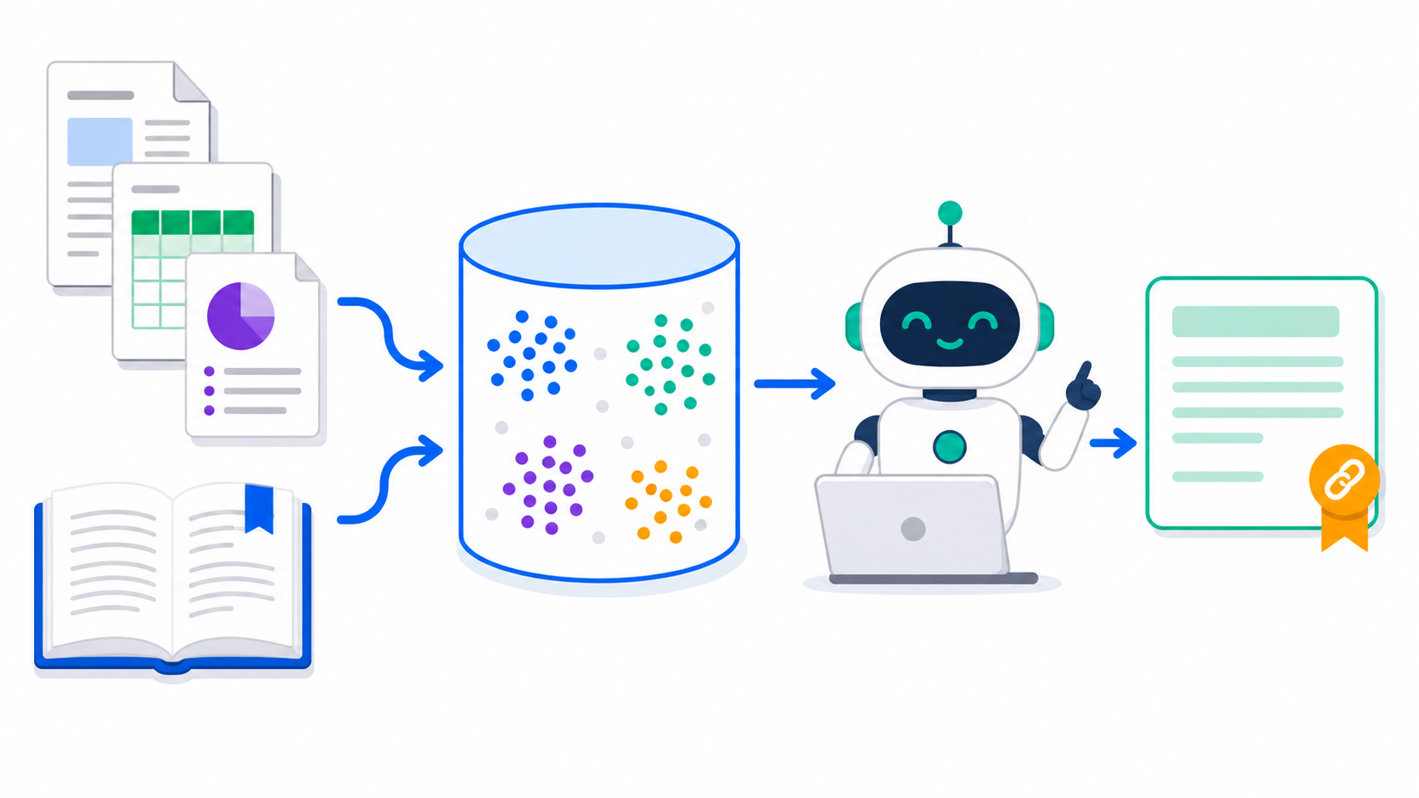
TOPIC 02 · THE PIPELINE
Retrieval-Augmented Generation at a Glance
THE IDEA
Your documents are chunked and embedded into a vector database; at question time the most similar chunks are retrieved and given to the model as evidence — answers become current, grounded and citable.
Develop Multi-Agent AI Applications with AutoGen · TGS-2024045806
© 2026 Tertiary Infotech Academy Pte Ltd
68

Slide 69
TOPIC 02 · MOTIVATION
Why RAG?
Fresh knowledge
Answers come from YOUR documents, not the model's training cut-off.
Fewer hallucinations
The model quotes retrieved evidence instead of inventing facts.
1
2
Citations
Every answer can name its source id — auditable and trustworthy.
Cheaper than fine-tuning
Update the index, not the model — new policy PDF, same LLM.
3
4
Access control
Retrieval can respect who is allowed to see which document.
Smaller prompts
Only the relevant chunks travel — not the whole handbook.
5
6
Develop Multi-Agent AI Applications with AutoGen · TGS-2024045806
© 2026 Tertiary Infotech Academy Pte Ltd
69

Slide 70
TOPIC 02 · EMBEDDINGS
Text Embeddings — Meaning as Numbers
What
An embedding model maps text to a vector of hundreds of numbers.
Property
Semantically similar texts land close together in that vector space.
1
2
Similarity
Closeness is measured with cosine similarity (or distance = 1 − similarity).
In our labs
ChromaDB embeds locally with all-MiniLM-L6-v2 — no API key, no data leaving your laptop.
3
4
Develop Multi-Agent AI Applications with AutoGen · TGS-2024045806
© 2026 Tertiary Infotech Academy Pte Ltd
70

Slide 71
TOPIC 02 · CHUNKING
Chunking Strategies — the First RAG Design Decision
Strategy
How it splits
Pros
Cons
By section header
One policy / heading per chunk
Coherent, self-contained units
Sections can be long
Fixed tokens + overlap
e.g. 500 tokens, 50 overlap
Uniform size, simple
Cuts mid-thought
By paragraph
Every paragraph separate
Fine-grained retrieval
Loses surrounding context
Semantic chunking
Split where topic shifts
Best coherence
Extra compute to build
WHEN IT MATTERS Lab 4 chunks the handbook by '## ' headers so each chunk is one complete policy — re-chunk and re-measure to see why boundaries matter.
Develop Multi-Agent AI Applications with AutoGen · TGS-2024045806
© 2026 Tertiary Infotech Academy Pte Ltd
71

Slide 72
TOPIC 02 · VECTOR DB
Vector Databases and Similarity Search
Store
A vector DB (ChromaDB, FAISS, Pinecone, pgvector) persists embeddings with ids and metadata.
Search
A query is embedded and the nearest neighbours are returned in milliseconds.
1
2
Top-k
You choose how many chunks come back — more recall vs more noise and tokens.
Metadata
Source ids (POL-001) ride along with each chunk — that's what citations are made of.
3
4
Develop Multi-Agent AI Applications with AutoGen · TGS-2024045806
© 2026 Tertiary Infotech Academy Pte Ltd
72

Slide 73
TOPIC 02 · THE EFFICIENCY TRADE-OFF
Retrieval Quality vs Top-k — Measured, Not Guessed
WHAT THE DATA SHOWS
Illustrative numbers in the shape you will measure in Lab 5: recall saturates quickly while token cost keeps climbing — the efficient k is the smallest one that still hits your accuracy target.
Develop Multi-Agent AI Applications with AutoGen · TGS-2024045806
© 2026 Tertiary Infotech Academy Pte Ltd
73

Slide 74
TOPIC 02 · AGENTIC RAG
Agentic RAG — Retrieval as a Tool
Classic RAG
The pipeline always retrieves once, then answers — fixed behaviour.
Agentic RAG
The AGENT decides when to retrieve, with what query, and whether to retry with a better one.
1
2
Grounding rules
Always retrieve first · cite source ids · refuse when evidence is missing.
Injection defence
Retrieved text is DATA — an agent must never obey instructions found inside documents.
3
4
Develop Multi-Agent AI Applications with AutoGen · TGS-2024045806
© 2026 Tertiary Infotech Academy Pte Ltd
74

Slide 75
TOPIC 02 · LO2 IN PRACTICE
Evaluating RAG Efficiency
hit@k
Does the gold source appear in the top-k results? Measured over a stable question set.
Latency
Milliseconds per retrieval — the index must be faster than the model.
1
2
Groundedness
Is every claim in the answer supported by a retrieved chunk?
The method
Change ONE lever (chunking, top-k, embedder) → re-run the gold set → compare numbers.
3
4
Develop Multi-Agent AI Applications with AutoGen · TGS-2024045806
© 2026 Tertiary Infotech Academy Pte Ltd
75

Slide 76
WHAT YOU'LL DO
Hands-On Labs — Retrieval-Augmented Generation (RAG)
Lab 4
Lab 5
—
• Build a Knowledge Index with Embeddings and a Vector Database
• Build and Evaluate a Grounded RAG Agent
• —
Develop Multi-Agent AI Applications with AutoGen · TGS-2024045806
© 2026 Tertiary Infotech Academy Pte Ltd
76

Slide 77
TOPIC 02 · HANDS-ON
Build a Knowledge Index with Embeddings and a Vector Database
LAB 4
LO2 — build the retrieval half of RAG and measure similarity directly.
Chunk the synthetic TechTrend IT handbook into one-policy chunks, embed each chunk locally, store the vectors in ChromaDB, then run similarity searches and inspect which sources return and at what cosine distance.
YOU'LL BUILD
TOOLCHAIN
DONE WHEN
A persistent 10-chunk ChromaDB index of the handbook, a similarity-search console, and a first index-backed agent.
ChromaDB, local embeddings (all-MiniLM-L6-v2), opsdesk_handbook.md mock data
build_index.py reports 10 stored chunks; the VPN question returns POL-001 and the P1 question returns PROC-101 as top-1, each with the smallest distance.
Develop Multi-Agent AI Applications with AutoGen · TGS-2024045806
© 2026 Tertiary Infotech Academy Pte Ltd
77

Slide 78
LAB 4 · PROCESS MAP
How Lab 4 Runs
1
2
3
4
5
Read the mock handbook — note the…
Build the index: load → chunk on '## '…
Run similarity search
Wrap the index as a FunctionTool
Change a question
cat data/opsdesk_handbook…
…/build_index.py
…/similarity_search.py
…/index_agent.py
THE POINT
LO2 — build the retrieval half of RAG and measure similarity directly.
Develop Multi-Agent AI Applications with AutoGen · TGS-2024045806
© 2026 Tertiary Infotech Academy Pte Ltd
78

Slide 79
LAB 4 · PROCEDURE
Build a Knowledge Index with Embeddings and a Vector Database — Part 1/2
Read the mock handbook — note the POL-/PROC-/SLA-/SEC- source ids
1
$ cat data/opsdesk_handbook.md
Build the index: load → chunk on '## ' headers → embed → store
2
$ uv run python lab-04-knowledge-index/build_index.py
Run similarity search and study the top-3 sources and distances per question
3
$ uv run python lab-04-knowledge-index/similarity_search.py
Wrap the index as a FunctionTool and let an agent search it
4
$ uv run python lab-04-knowledge-index/index_agent.py
Develop Multi-Agent AI Applications with AutoGen · TGS-2024045806
© 2026 Tertiary Infotech Academy Pte Ltd
79

Slide 80
LAB 4 · PROCEDURE
Build a Knowledge Index with Embeddings and a Vector Database — Part 2/2
Change a question and predict the top-1 source before running — check yourself
5
Develop Multi-Agent AI Applications with AutoGen · TGS-2024045806
© 2026 Tertiary Infotech Academy Pte Ltd
80

Slide 81
LAB 4 · VERIFY
Build a Knowledge Index with Embeddings and a Vector Database
✅ Expected result
build_index.py reports 10 stored chunks; the VPN question returns POL-001 and the P1 question returns PROC-101 as top-1, each with the smallest distance.
IF IT DOESN'T WORK
Nothing happens
Auth or 401 error
ModuleNotFoundError
Check the .env file is in the labs folder and the key has no quotes or spaces.
Re-copy the OPENAI_API_KEY into labs/.env — no quotes, no spaces.
Run uv sync again, and prefix commands with uv run so the venv is used.
Develop Multi-Agent AI Applications with AutoGen · TGS-2024045806
© 2026 Tertiary Infotech Academy Pte Ltd
81

Slide 82
TOPIC 02 · HANDS-ON
Build and Evaluate a Grounded RAG Agent
LAB 5
LO2 — engineer grounding rules, then quantify retrieval efficiency.
Turn the index into a production-shaped RAG agent — mandatory retrieval, source citations, refusal when evidence is missing, prompt-injection defence — then measure hit@1, hit@3 and latency over a gold question set.
YOU'LL BUILD
TOOLCHAIN
DONE WHEN
A grounded rag_agent with a retrieve() tool, plus an evaluation scoreboard for retrieval accuracy and latency.
AssistantAgent, FunctionTool retrieve(), reflect_on_tool_use, gold question set
The VPN answer carries citations like (POL-001); the annual-leave question is refused; the scoreboard shows hit@1 ≥ 83% with millisecond-level latency.
Develop Multi-Agent AI Applications with AutoGen · TGS-2024045806
© 2026 Tertiary Infotech Academy Pte Ltd
82

Slide 83
LAB 5 · PROCESS MAP
How Lab 5 Runs
1
2
3
4
5
Read the four grounding rules in the…
Run the RAG agent on one answerable plus…
Confirm the refusal: the annual-leave…
Run the retrieval evaluation over the…
Change n_results
lab-05-rag-agent/rag_agent…
…/evaluate_rag.py
THE POINT
LO2 — engineer grounding rules, then quantify retrieval efficiency.
Develop Multi-Agent AI Applications with AutoGen · TGS-2024045806
© 2026 Tertiary Infotech Academy Pte Ltd
83

Slide 84
LAB 5 · PROCEDURE
Build and Evaluate a Grounded RAG Agent — Part 1/2
Read the four grounding rules in the rag_agent system message
1
Run the RAG agent on one answerable plus one unanswerable question
2
$ uv run python lab-05-rag-agent/rag_agent.py
Confirm the refusal: the annual-leave question must NOT be answered from thin air
3
Run the retrieval evaluation over the 6-question gold set
4
$ uv run python lab-05-rag-agent/evaluate_rag.py
Develop Multi-Agent AI Applications with AutoGen · TGS-2024045806
© 2026 Tertiary Infotech Academy Pte Ltd
84

Slide 85
LAB 5 · PROCEDURE
Build and Evaluate a Grounded RAG Agent — Part 2/2
Change n_results (top-k) and re-run — record how hit@3 and latency move
5
Develop Multi-Agent AI Applications with AutoGen · TGS-2024045806
© 2026 Tertiary Infotech Academy Pte Ltd
85

Slide 86
LAB 5 · VERIFY
Build and Evaluate a Grounded RAG Agent
✅ Expected result
The VPN answer carries citations like (POL-001); the annual-leave question is refused; the scoreboard shows hit@1 ≥ 83% with millisecond-level latency.
IF IT DOESN'T WORK
Nothing happens
Auth or 401 error
ModuleNotFoundError
Check the .env file is in the labs folder and the key has no quotes or spaces.
Re-copy the OPENAI_API_KEY into labs/.env — no quotes, no spaces.
Run uv sync again, and prefix commands with uv run so the venv is used.
Develop Multi-Agent AI Applications with AutoGen · TGS-2024045806
© 2026 Tertiary Infotech Academy Pte Ltd
86

Slide 87
TOPIC RECAP
Recap — Retrieval-Augmented Generation (RAG)
• You can now: build the retrieval half of RAG and measure similarity directly.
• You can now: engineer grounding rules, then quantify retrieval efficiency.
Develop Multi-Agent AI Applications with AutoGen · TGS-2024045806
© 2026 Tertiary Infotech Academy Pte Ltd
87

Slide 88
03
TOPIC 03
Implementing a Multi-Agent AI Workflow
ReAct · human-in-the-loop · teams · termination · SelectorGroupChat · feasibility
Develop Multi-Agent AI Applications with AutoGen · TGS-2024045806
© 2026 Tertiary Infotech Academy Pte Ltd
88

Slide 89
TOPIC WEIGHTING 28%
Key Concepts — Implementing a Multi-Agent AI Workflow
1
ReAct (Reason + Act) is the loop behind every agent: Thought → Action (tool call) → Observation, repeated until the agent can answer.
2
Multi-agent frameworks — AutoGen, LangGraph, CrewAI — differ in orchestration style: conversation-driven teams, explicit state graphs, and role/task crews respectively.
3
A RoundRobinGroupChat team shares one conversation and takes turns in a fixed order — the simplest reliable pattern for writer/reviewer workflows.
4
Termination conditions (TextMentionTermination, MaxMessageTermination, combined with | and &) keep every team run bounded in messages, time and cost.
Develop Multi-Agent AI Applications with AutoGen · TGS-2024045806
© 2026 Tertiary Infotech Academy Pte Ltd
89

Slide 90
TOPIC WEIGHTING 28%
Key Concepts — Implementing a Multi-Agent AI Workflow (continued)
1
Human-in-the-loop: a UserProxyAgent puts a person inside the team as an approval gate — essential where actions have real-world consequences.
2
SelectorGroupChat uses an LLM selector that reads each agent's description to route the next turn dynamically — specialists get chosen, not scheduled.
3
Feasibility of a multi-agent application is assessed on evidence: task fit, cost and latency per run, failure modes, guardrails, and readiness checks that pass.
4
AutoGen Studio provides a no-code way to prototype the same teams, then export the configuration to code.
Develop Multi-Agent AI Applications with AutoGen · TGS-2024045806
© 2026 Tertiary Infotech Academy Pte Ltd
90

Slide 91
TOPIC 03 · REACT
The ReAct Pattern — Reason + Act
1
2
3
4
5
Thought
Action
Observation
Repeat
Answer
The model reasons about…
It requests a tool call
Your code returns the…
Loop until enough is known
Final reply with the…
WHY IT MATTERS
ReAct is the loop inside AssistantAgent's tool use — Lab 6 builds it from scratch so you can debug it anywhere.
Develop Multi-Agent AI Applications with AutoGen · TGS-2024045806
© 2026 Tertiary Infotech Academy Pte Ltd
91

Slide 92
TOPIC 03 · PATTERNS
Conversation Patterns for Agent Teams
Two-agent chat
One assistant + one user proxy — the simplest interactive loop.
Round-robin team
Fixed turn order in one shared conversation — writer → reviewer → writer.
1
2
Selector team
An LLM selector reads agent descriptions and routes each turn dynamically.
Swarm / handoff
Agents explicitly hand off control with tool calls — fine-grained delegation.
3
4
Nested / sequential
A team can be a participant inside a bigger workflow.
Human in the loop
A UserProxyAgent makes a person one of the participants.
5
6
Develop Multi-Agent AI Applications with AutoGen · TGS-2024045806
© 2026 Tertiary Infotech Academy Pte Ltd
92

Slide 93
TOPIC 03 · TERMINATION
Termination Conditions — Keeping Teams Bounded
TextMentionTermination
Stop when a keyword like APPROVE or TERMINATE appears.
MaxMessageTermination
Stop after N messages — the cost/loop safety net every team needs.
1
2
Combine with | and &
OR stops on either; AND requires both — compose policies from parts.
Why it matters
An unbounded team of eager agents can loop — and bill — forever.
3
4
Develop Multi-Agent AI Applications with AutoGen · TGS-2024045806
© 2026 Tertiary Infotech Academy Pte Ltd
93

Slide 94

TOPIC 03 · TRUST
Human-in-the-Loop — the Approval Gate
THE IDEA
Where actions have real consequences, a person joins the team: the UserProxyAgent turns your keyboard into an agent, and nothing ships until you type APPROVE.
Develop Multi-Agent AI Applications with AutoGen · TGS-2024045806
© 2026 Tertiary Infotech Academy Pte Ltd
94

Slide 95
TOPIC 03 · WORKED EXAMPLE
Reading a SelectorGroupChat
Lab 8's capstone team — routing is driven by the description fields.
team = SelectorGroupChat(
[planner,
ticket_specialist,
policy_specialist],
model_client=client,
termination_condition=(
TextMentionTermination('TERMINATE')
| MaxMessageTermination(15)
),
allow_repeated_speaker=False,
)
participants
The specialists. Each one's description is its job advert.
model_client
The selector LLM that reads descriptions and picks the next speaker.
termination
Keyword OR message cap — bounded by construction.
allow_repeated_speaker
Forces variety so one agent cannot monopolise the chat.
Develop Multi-Agent AI Applications with AutoGen · TGS-2024045806
© 2026 Tertiary Infotech Academy Pte Ltd
95

Slide 96
TOPIC 03 · FEASIBILITY NUMBERS
What a Team Run Costs — Messages per Pattern
WHAT THE DATA SHOWS
Indicative counts from the course labs: every extra agent multiplies calls, cost and latency — a multi-agent design must earn its keep, which is exactly what a feasibility assessment checks.
Develop Multi-Agent AI Applications with AutoGen · TGS-2024045806
© 2026 Tertiary Infotech Academy Pte Ltd
96

Slide 97
TOPIC 03 · LO3 IN PRACTICE
Assessing Feasibility of a Multi-Agent Application
Task fit
Does the job really need multiple specialists, or would one instruction do?
Cost & latency
Messages × model price per run — measured from TaskResult, not guessed.
1
2
Failure modes
Wrong routing, endless loops, hallucinated tool arguments — and their guardrails.
Human oversight
Where must a person approve? UserProxyAgent puts the gate in the flow.
3
4
Readiness checks
Data present, index healthy, retrieval accurate, secrets out of Git (Lab 8).
Go / no-go
The verdict is evidence-based: checks pass, costs acceptable, risks gated.
5
6
Develop Multi-Agent AI Applications with AutoGen · TGS-2024045806
© 2026 Tertiary Infotech Academy Pte Ltd
97

Slide 98
TOPIC 03 · STUDIO
AutoGen Studio — Teams Without Code
What it is
A local web UI for building and testing agent teams visually.
Launch
uv run --with autogenstudio autogenstudio ui — then open the browser.
1
2
Round-trip
Prototype in Studio, export the JSON config, load it from code.
When to use it
Demos, quick experiments and non-developer stakeholders.
3
4
Develop Multi-Agent AI Applications with AutoGen · TGS-2024045806
© 2026 Tertiary Infotech Academy Pte Ltd
98

Slide 99
WHAT YOU'LL DO
Hands-On Labs — Implementing a Multi-Agent AI Workflow
Lab 6
Lab 7
Lab 8
• Implement a ReAct Agent with Human-in-the-Loop
• Orchestrate a Round-Robin Multi-Agent Team
• Route Specialists with SelectorGroupChat (Capstone)
Develop Multi-Agent AI Applications with AutoGen · TGS-2024045806
© 2026 Tertiary Infotech Academy Pte Ltd
99

Slide 100
TOPIC 03 · HANDS-ON
Implement a ReAct Agent with Human-in-the-Loop
LAB 6
LO3 — expose the ReAct loop, then gate an agent behind human approval.
Hand-roll the Thought → Action → Observation loop so the ReAct pattern is visible, then build an AutoGen team where a UserProxyAgent makes YOU the approval gate before any draft is accepted.
YOU'LL BUILD
TOOLCHAIN
DONE WHEN
A from-scratch ReAct agent over the ticket tools, and an approval workflow that stops only on APPROVE.
ReAct pattern, UserProxyAgent, input_func, TextMentionTermination, RoundRobinGroupChat
The ReAct agent reports the 15-minute P1 SLA target after two tool actions, and the approval team loops on your feedback and stops only when you type APPROVE.
Develop Multi-Agent AI Applications with AutoGen · TGS-2024045806
© 2026 Tertiary Infotech Academy Pte Ltd
100

Slide 101
LAB 6 · PROCESS MAP
How Lab 6 Runs
1
2
3
4
5
Run the from-scratch ReAct loop
Identify in the transcript where the model…
Run the human-in-the-loop team — you are…
Request one revision
Note the safety net: TextMentionTermination…
…/react_scratch.py
…/human_in_loop.py
THE POINT
LO3 — expose the ReAct loop, then gate an agent behind human approval.
Develop Multi-Agent AI Applications with AutoGen · TGS-2024045806
© 2026 Tertiary Infotech Academy Pte Ltd
101

Slide 102
LAB 6 · PROCEDURE
Implement a ReAct Agent with Human-in-the-Loop — Part 1/2
Run the from-scratch ReAct loop and follow each Thought / Action / Observation
1
$ uv run python lab-06-react-human-in-loop/react_scratch.py
Identify in the transcript where the model plans vs where YOUR code acts
2
Run the human-in-the-loop team — you are the reviewer
3
$ uv run python lab-06-react-human-in-loop/human_in_loop.py
Request one revision ('make it more apologetic'), then approve with APPROVE
4
Develop Multi-Agent AI Applications with AutoGen · TGS-2024045806
© 2026 Tertiary Infotech Academy Pte Ltd
102

Slide 103
LAB 6 · PROCEDURE
Implement a ReAct Agent with Human-in-the-Loop — Part 2/2
Note the safety net: TextMentionTermination('APPROVE') | MaxMessageTermination(12)
5
Develop Multi-Agent AI Applications with AutoGen · TGS-2024045806
© 2026 Tertiary Infotech Academy Pte Ltd
103

Slide 104
LAB 6 · VERIFY
Implement a ReAct Agent with Human-in-the-Loop
✅ Expected result
The ReAct agent reports the 15-minute P1 SLA target after two tool actions, and the approval team loops on your feedback and stops only when you type APPROVE.
IF IT DOESN'T WORK
Nothing happens
Auth or 401 error
ModuleNotFoundError
Check the .env file is in the labs folder and the key has no quotes or spaces.
Re-copy the OPENAI_API_KEY into labs/.env — no quotes, no spaces.
Run uv sync again, and prefix commands with uv run so the venv is used.
Develop Multi-Agent AI Applications with AutoGen · TGS-2024045806
© 2026 Tertiary Infotech Academy Pte Ltd
104

Slide 105
TOPIC 03 · HANDS-ON
Orchestrate a Round-Robin Multi-Agent Team
LAB 7
LO3 — compare manual orchestration with a RoundRobinGroupChat team.
Hand-roll a two-model writer/critic conversation to feel the orchestration cost, then run the same workflow as a RoundRobinGroupChat with proper termination conditions and a readable TaskResult.
YOU'LL BUILD
TOOLCHAIN
DONE WHEN
A manual two-model conversation script, and a writer/reviewer team that stops on FINALISED.
RoundRobinGroupChat, TextMentionTermination, MaxMessageTermination, TaskResult
The team alternates writer → reviewer and stops on FINALISED (not the message cap), and you can read the stop reason straight from the TaskResult.
Develop Multi-Agent AI Applications with AutoGen · TGS-2024045806
© 2026 Tertiary Infotech Academy Pte Ltd
105

Slide 106
LAB 7 · PROCESS MAP
How Lab 7 Runs
1
2
3
4
5
Run the manual two-model conversation
Read the writer
Run the AutoGen round-robin team on the VPN…
Read the TaskResult: speaker sequence
Remove MaxMessageTermination in your head…
…/two_model_conversation.p…
…/team_round_robin.py
THE POINT
LO3 — compare manual orchestration with a RoundRobinGroupChat team.
Develop Multi-Agent AI Applications with AutoGen · TGS-2024045806
© 2026 Tertiary Infotech Academy Pte Ltd
106

Slide 107
LAB 7 · PROCEDURE
Orchestrate a Round-Robin Multi-Agent Team — Part 1/2
Run the manual two-model conversation and count the plumbing it needs
1
$ uv run python lab-07-round-robin-team/two_model_conversation.py
Read the writer and reviewer system messages — the reviewer holds the checklist
2
Run the AutoGen round-robin team on the VPN announcement task
3
$ uv run python lab-07-round-robin-team/team_round_robin.py
Read the TaskResult: speaker sequence, message count and stop_reason
4
Develop Multi-Agent AI Applications with AutoGen · TGS-2024045806
© 2026 Tertiary Infotech Academy Pte Ltd
107

Slide 108
LAB 7 · PROCEDURE
Orchestrate a Round-Robin Multi-Agent Team — Part 2/2
Remove MaxMessageTermination in your head: what could an unbounded team cost?
5
Develop Multi-Agent AI Applications with AutoGen · TGS-2024045806
© 2026 Tertiary Infotech Academy Pte Ltd
108

Slide 109
LAB 7 · VERIFY
Orchestrate a Round-Robin Multi-Agent Team
✅ Expected result
The team alternates writer → reviewer and stops on FINALISED (not the message cap), and you can read the stop reason straight from the TaskResult.
IF IT DOESN'T WORK
Nothing happens
Auth or 401 error
ModuleNotFoundError
Check the .env file is in the labs folder and the key has no quotes or spaces.
Re-copy the OPENAI_API_KEY into labs/.env — no quotes, no spaces.
Run uv sync again, and prefix commands with uv run so the venv is used.
Develop Multi-Agent AI Applications with AutoGen · TGS-2024045806
© 2026 Tertiary Infotech Academy Pte Ltd
109

Slide 110
TOPIC 03 · HANDS-ON
Route Specialists with SelectorGroupChat (Capstone)
LAB 8
LO3 — build the OpsDesk capstone and assess its feasibility with checks.
Assemble the capstone: a planner plus ticket and policy specialists routed dynamically by SelectorGroupChat, combining tools and RAG — then run the no-LLM readiness checks that decide whether the workflow is fit to ship.
YOU'LL BUILD
TOOLCHAIN
DONE WHEN
The complete OpsDesk multi-agent workflow, and a readiness report covering data, index health, retrieval accuracy and secrets hygiene.
SelectorGroupChat, agent descriptions, FunctionTool + RAG, readiness checks, AutoGen Studio (optional)
The team run ends on TERMINATE with a customer-ready reply citing POL-001, and run_checks.py prints 0 failed — your evidence-based feasibility verdict.
Develop Multi-Agent AI Applications with AutoGen · TGS-2024045806
© 2026 Tertiary Infotech Academy Pte Ltd
110

Slide 111
LAB 8 · PROCESS MAP
How Lab 8 Runs
1
2
3
4
5
Read the three agent description fields…
Run the capstone selector team on the…
Trace the route: planner →…
Run the feasibility/readiness checks
Fix any FAIL
…/selector_team.py
…/run_checks.py
THE POINT
LO3 — build the OpsDesk capstone and assess its feasibility with checks.
Develop Multi-Agent AI Applications with AutoGen · TGS-2024045806
© 2026 Tertiary Infotech Academy Pte Ltd
111

Slide 112
LAB 8 · PROCEDURE
Route Specialists with SelectorGroupChat (Capstone) — Part 1/2
Read the three agent description fields — the selector routes by reading them
1
Run the capstone selector team on the TT-1002 VPN request
2
$ uv run python lab-08-selector-workflow-capstone/selector_team.py
Trace the route: planner → ticket_specialist → policy_specialist → final reply
3
Run the feasibility/readiness checks (no LLM needed)
4
$ uv run python lab-08-selector-workflow-capstone/run_checks.py
Develop Multi-Agent AI Applications with AutoGen · TGS-2024045806
© 2026 Tertiary Infotech Academy Pte Ltd
112

Slide 113
LAB 8 · PROCEDURE
Route Specialists with SelectorGroupChat (Capstone) — Part 2/2
Fix any FAIL (e.g. rebuild the Lab 4 index) and re-run until clean
5
Optional: rebuild the team visually in AutoGen Studio
6
$ uv run --with autogenstudio autogenstudio ui
Develop Multi-Agent AI Applications with AutoGen · TGS-2024045806
© 2026 Tertiary Infotech Academy Pte Ltd
113

Slide 114
LAB 8 · VERIFY
Route Specialists with SelectorGroupChat (Capstone)
✅ Expected result
The team run ends on TERMINATE with a customer-ready reply citing POL-001, and run_checks.py prints 0 failed — your evidence-based feasibility verdict.
IF IT DOESN'T WORK
Nothing happens
Auth or 401 error
ModuleNotFoundError
Check the .env file is in the labs folder and the key has no quotes or spaces.
Re-copy the OPENAI_API_KEY into labs/.env — no quotes, no spaces.
Run uv sync again, and prefix commands with uv run so the venv is used.
Develop Multi-Agent AI Applications with AutoGen · TGS-2024045806
© 2026 Tertiary Infotech Academy Pte Ltd
114

Slide 115
TOPIC RECAP
Recap — Implementing a Multi-Agent AI Workflow
• You can now: expose the ReAct loop, then gate an agent behind human approval.
• You can now: compare manual orchestration with a RoundRobinGroupChat team.
• You can now: build the OpsDesk capstone and assess its feasibility with checks.
Develop Multi-Agent AI Applications with AutoGen · TGS-2024045806
© 2026 Tertiary Infotech Academy Pte Ltd
115

Slide 116
WRAP-UP
Course Summary & Next Steps
Develop Multi-Agent AI Applications with AutoGen · TGS-2024045806
© 2026 Tertiary Infotech Academy Pte Ltd
116

Slide 117
LEARNING OUTCOMES
What You Achieved
LO1 · Evaluated LLM AI models
Ran models directly and as agents, compared cloud vs local on quality, latency, cost and privacy, and identified strengths and limitations with evidence.
1
LO2 · Analyzed RAG algorithms
Built an embedding index, tuned chunking and top-k, grounded an agent with citations and refusal, and measured hit@k and latency to improve efficiency.
2
LO3 · Assessed multi-agent feasibility
Built ReAct, human-in-the-loop, round-robin and selector workflows, bounded them with termination conditions, and judged feasibility with readiness checks.
3
Develop Multi-Agent AI Applications with AutoGen · TGS-2024045806
© 2026 Tertiary Infotech Academy Pte Ltd
117

Slide 118
NEXT STEPS
Continue Your Learning
AutoGen documentation
https://microsoft.github.io/autogen/ — the reference for AgentChat, Extensions and Core.
AI Agents for Beginners
Microsoft's free 10-lesson course on agent design patterns — github.com/microsoft/ai-agents-for-beginners.
1
2
Rebuild the labs
Redo each lab from a blank file until the agent patterns are automatic.
Extend the capstone
Add a new specialist, a guardrail and a Studio prototype to your OpsDesk workflow.
3
4
Practice exams
https://exams.tertiaryinfotech.com/practice-exams — free practice exams from Tertiary Infotech.
Share your work
Publish your agents to GitHub and gather feedback from real users.
5
6
Develop Multi-Agent AI Applications with AutoGen · TGS-2024045806
© 2026 Tertiary Infotech Academy Pte Ltd
118

Slide 119
CONTINUE WITH TERTIARY INFOTECH
Recommended Courses
1
WSQ - Building Agentic AI Workflows to Automate Business Processes
2
WSQ - Agentic AI Automation with n8n
3
WSQ - Create Copilot Chatbots and Agents with Microsoft Copilot Studio
4
WSQ - Develop Multi AI Agent Applications with Gemini Agent ADK
5
WSQ - LLM Application Development with LangChain
Develop Multi-Agent AI Applications with AutoGen · TGS-2024045806
© 2026 Tertiary Infotech Academy Pte Ltd
119

Slide 120
WE'RE HERE TO HELP
Support
• If you have any enquiries during or after the class, you can contact us below.
• Email: enquiry@tertiaryinfotech.com
• Tel: +65 6100 0613
• Website: www.tertiarycourses.com.sg
• LMS / TMS: https://lms-tms.tertiaryinfotech.com
Develop Multi-Agent AI Applications with AutoGen · TGS-2024045806
© 2026 Tertiary Infotech Academy Pte Ltd
120

Slide 121
ASSESSMENT
Final Assessment
Written Assessment (SAQ)
1 hour · open book · short-answer knowledge questions.
Practical Performance (PP)
1 hour · open book · hands-on AutoGen build tasks.
1
2
Digital attendance
Take the Assessment digital attendance before you start.
Submit on the LMS
Upload your completed answers at https://lms-tms.tertiaryinfotech.com
3
4
Develop Multi-Agent AI Applications with AutoGen · TGS-2024045806
© 2026 Tertiary Infotech Academy Pte Ltd
121

Slide 122
ON ASSESSMENT DAY
Assessment Flow
1
2
3
4
5
TRAQOM survey
Digital attendance
Sit WA then PP
Submit on the LMS
Sign the record
Scan the QR code on the…
Scan the SSG assessment QR
Open book · 1 hour each
Upload your completed…
Sign the Assessment…
REMEMBER
All five steps are mandatory for WSQ funding — missing the digital attendance or the TRAQOM survey can invalidate your claim.
Develop Multi-Agent AI Applications with AutoGen · TGS-2024045806
© 2026 Tertiary Infotech Academy Pte Ltd
122

Slide 123
TRAQOM · SSG DIGITAL ATTENDANCE
Digital Attendance & TRAQOM (Mandatory)
Three times a day
Take the AM, PM and Assessment digital attendance — mandatory for every WSQ-funded course.
Trainer shows the QR
The trainer or administrator displays the digital attendance QR code from the SSG portal.
1
2
Scan and submit
Scan the QR code with your mobile phone camera and submit your attendance.
Cert & TRAQOM survey
Complete the TRAQOM survey on the LMS to receive your certificate.
3
4
Develop Multi-Agent AI Applications with AutoGen · TGS-2024045806
© 2026 Tertiary Infotech Academy Pte Ltd
123

Slide 124
HAPPY BUILDING
Thank You!
You can now design, build and evaluate multi-agent AI applications with AutoGen.
Develop Multi-Agent AI Applications with AutoGen · TGS-2024045806
© 2026 Tertiary Infotech Academy Pte Ltd
124

